Slide 1

AMERICAN INTERNATIONAL UNIVERSITY-BANGLADESH ELECTRINIC DEVICES [R] PRESENTATION PRESENTAED TO; MD. RABIUL ISLAM
Presented by; most afroja mahomuda
Id; 20-43554-1
Topic; uses of diode and its practical application in real life

Slide 2
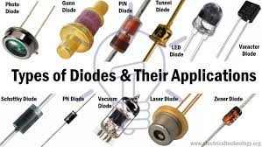
Uses of diode and its practical application in real life.
What is Diode:
A diode is a two-terminal electronic component that conducts current primarily in one direction; it has low resistance in one direction, and high resistance in the other.
Types of Diode:
There are different Types of diodes such as small signal diode,large signal diode, zener Diode, light emitting diode (LED),constant current diodes etc.

Slide 3
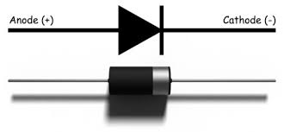
Diode working method;
Firstly an ideal diode is enclosed in a plastic or glass case to mark the cathode side of it. There are two ways a diode functions which is a forward-biased and a reverse-biased. Forward biased in which current flows from anode to cathode and reverse bias in which current flows from cathode to anode.

Slide 4
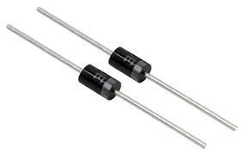
Function of diode;
The common function of a diode is to allow an electric current to pass in one direction which is forward direction and while blocking it in the opposite direction which is reverse direction. Also the diode can be viewed as an electronic version of a check valve.

Slide 5
Uses of Diode and its applications in real life;
As a simplest semiconductor component, diode has a wide variety of applications in modern electronic systems. Various electronic and electrical circuits use this component as an essential device to produce the required outcome.
Diodes can be used as rectifiers, signal limiters, voltage regulators, switches, signal modulators, signal mixers, signal demodulators, and oscillators.
It is used to remove negative signals from AC current.
The common and important application of a diode is the rectification of AC power to DC power.
Diodes can also perform digital logic operations.

Slide 6
Diodes help in performing digital logic. Millions of diodes are used similar to logic gates and used in modern processors.
The LEDs are used in sensors and also in laser devices any many other light illumination devices.
Zener diodes are used as voltage regulators and varactors are used in electronic tuning.
one of the major uses of diodes is to remove negative signals from AC current. This is known as signal demodulation. This function is basically used in radios as a filtering system in order to extract radio signals from a carrier wave.

Slide 7
They are also used in creating power supplies and voltage doublers.
Combination of a diode with a capacitor will help to make small AC voltage multiply to create a very high voltage.
These were some of the uses and applications of diodes that can be seen in our day to day life.

Slide 8


Slide 9


